Slide 1
Airline Passenger Satisfaction
Mudit Aggrawal , Jenny Yao , Pedro Jose Trujillo Mejia​, Liliana Tretyakova, ​ Hong-Fei Jin , Himanshu Mayank ​, Nilanjana Raghu ​, Ylfa Liang

Slide 2
Introduction
To Our Dataset and
Business Problem

Slide 3

Business Problem
What factors affect customer satisfaction the most in the context of airline passengers?
"Travel companies are still absorbing COVID-19’s financial impact, and investing in CX now may seem too great a burden for many of them.​
But companies that prioritize CX during a downturn stand to outperform their competition for years to come—as McKinsey research on the 2007–09 downturn has shown.​
Indeed, wise investment in CX may be key to the industry’s survival, and flourishing, in a post-pandemic world."
Notes:
Why using classification model? (we're predicting passenger satisfaction for what?)

Slide 4

Dataset
23 variables
including Satisfaction, Flight distance, Type of Travel
103,904
Observations from an airline passenger satisfaction survey
Notes:
Satisfaction: Airline satisfaction level(Satisfaction, neutral or dissatisfaction)​
Flight distance: The flight distance of this journey​
Type of Travel: Purpose of the flight of the passengers (Personal Travel, Business Travel)

Slide 5
Methodology
And Description of Our
Current Model

Slide 6
More about the Data
 | Neutral or dissatisfied | Satisfied
Numbers | 58, 246 | 44, 618
Percentage | 57% | 43%
X_train, X_test, y_train, y_test = train_test_split(X, y, test_size = 0.33, random_state = 5)

Slide 7
Models We Tried
Logistic regression
SVM
Decision tree
Random Forest
And others
Notes:
Include model comparison (i.e. accuracy)
Train test split methods

Slide 8
Model Comparison
Decision Tree
Logistic Regression
SVM
87%
88%
95%
Precision
Accuracy
Accuracy
84%
Random Forest
Recall
96%
Classification score

Slide 9
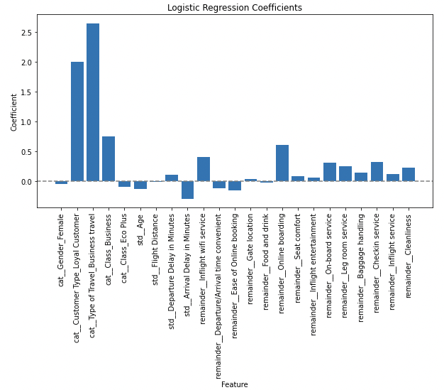
Classification – Logistic Regression

Slide 10
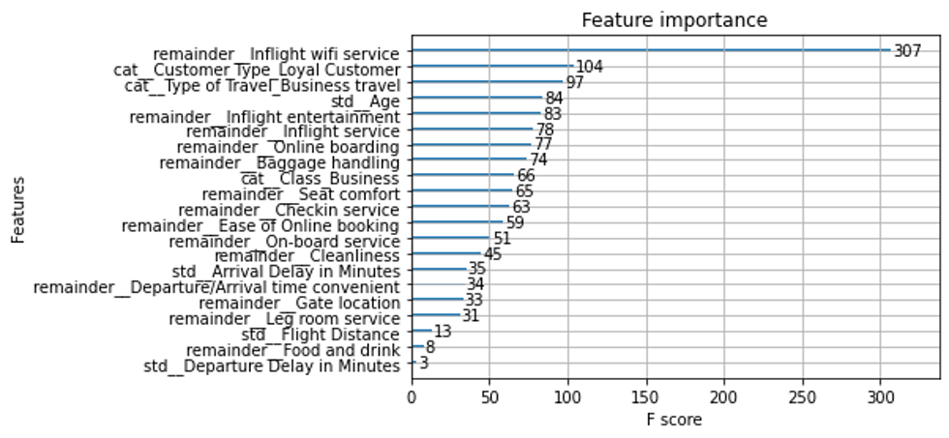
Classification – XGboost

Slide 11
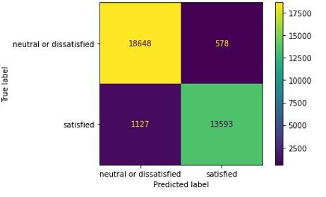
Classification – XGboost
94.98%
 | Precision | Recall | F1-Score | Support
Neutral or dissatisfied | 0.94 | 0.91 | 0.96 | 19226
Satisfied | 0.96 | 0.84 | 0.94 | 14720
Accuracy |  |  | 0.95 | 33946
Macro avg | 0.95 | 0.95 | 0.95 | 33946
Weighted avg | 0.95 | 0.95 | 0.95 | 33946
Accuracy
Using the best parameters

Slide 12

Causal Inference
XGboost
Base Model (Regressor)
Inflight
Wi-Fi service
Online
boarding
S, T, and X-learner
Treatment I
Treatment II
Meta Learner

Slide 13
Takeaways
Our Preliminary Results and Business Insights

Slide 14
Preliminary Results
Treatment I: Inflight Wi-Fi service
 | Business Travel
No | 0.361
YES | 0.174
 | LoYal Customer
No | 0.457
YES | 0.182
 | Flight Distance
Mid-long | o.03
Short | 0.303
CATE

Slide 15
Preliminary Results
Treatment II: Online boarding
 | Age
0-15 | o.027
18-40 | 0.069
41-65 | 0.047
65+ | 0.032
 | Business Travel
No | 0.008
YES | 0.077
 | LoYal Customer
No | 0.019
YES | 0.064
CATE

Slide 16

Business Insights
Wi-Fi Importance
Loyalty Customers
Preference
Age-specific strategies
Customers on short-distance flights or personal travel customers value Wi-Fi quality
These customers value a positive online boarding experience more than quality of in-flight Wi-Fi
Customers of different age groups are looking for different experiences

Slide 17
What next?
Develop a progressive scale to assess customer satisfaction

Slide 18
Thank you!
Any questions?

Slide 19
Appendix

Slide 20
Our Team
Mudit Aggarwal – Muditmoody
Hong Fei Jin - jinh1004
Ying-Fang Liang – yingfangliang
Himanshu Mayank - hm6650
Nilanjana R Raghu - Nilanjana-Raghu
Liliana Tretyakova - uliana-tr
Pedro Trujillo Mejia – PedroJoseTrujilloMejia
Jenny Yao - Jiaying-Yao

Slide 21
Information
Git Project - https://github.com/orgs/McGill-MMA-EnterpriseAnalytics/projects/29
Git repository - https://github.com/McGill-MMA-EnterpriseAnalytics/Flyer_Customer_Satisfaction

Slide 22
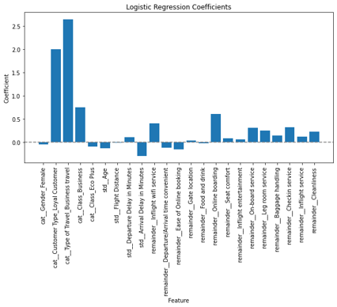
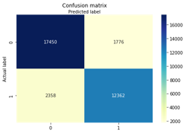
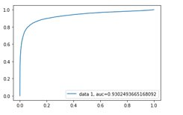
Classification – Logistic regression
87%
Precision
84%
Recall

Slide 23
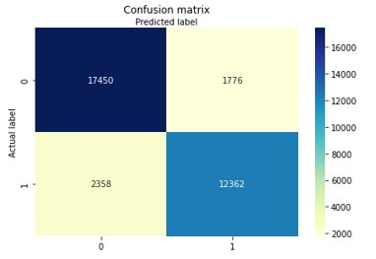
Classification - SVM
 | Precision | Recall | F1-Score | Support
Neutral or dissatisfied | 0.88 | 0.91 | 0.89 | 19226
Satisfied | 0.87 | 0.84 | 0.86 | 14720
Accuracy |  |  | 0.88 | 33946
Macro avg | 0.88 | 0.87 | 0.88 | 33946
Weighted avg | 0.88 | 0.88 | 0.88 | 33946
88%
Accuracy

Slide 24
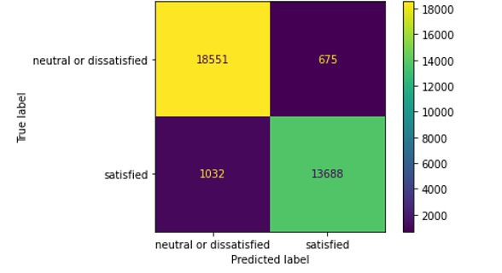
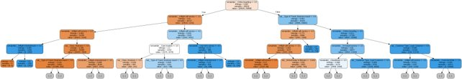
Classification – Decision trees ​
94.89%
15
94.94%
Accuracy
‘max_depth’
Accuracy
In train dataset
In test dataset
Part of the Decision tree generated

Slide 25
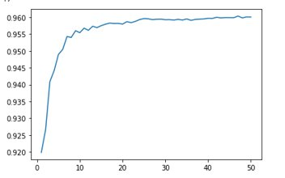
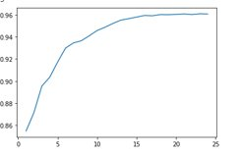
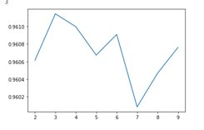
Classification – Random Forests
n_estimators vs Accuracy
Max_depth vs Accuracy
min_samples_split​ vs Accuracy​
The best classification score is 0.96​

Slide 26
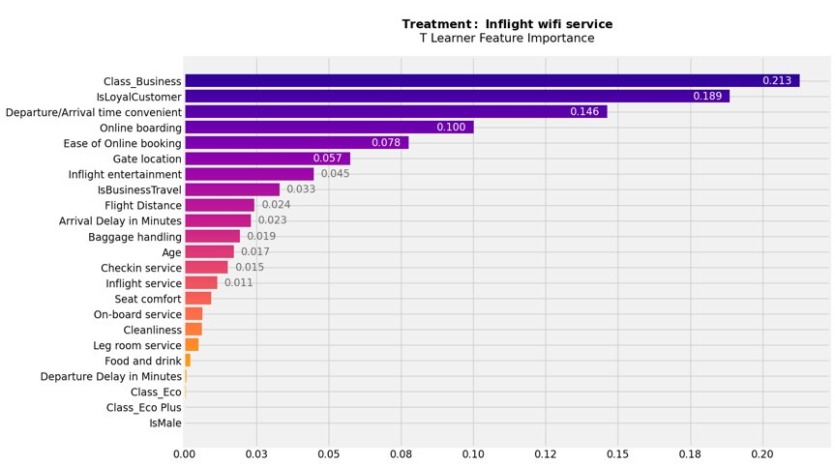
Preliminary Results
Treatment I: Inflight Wi-Fi service

Slide 27
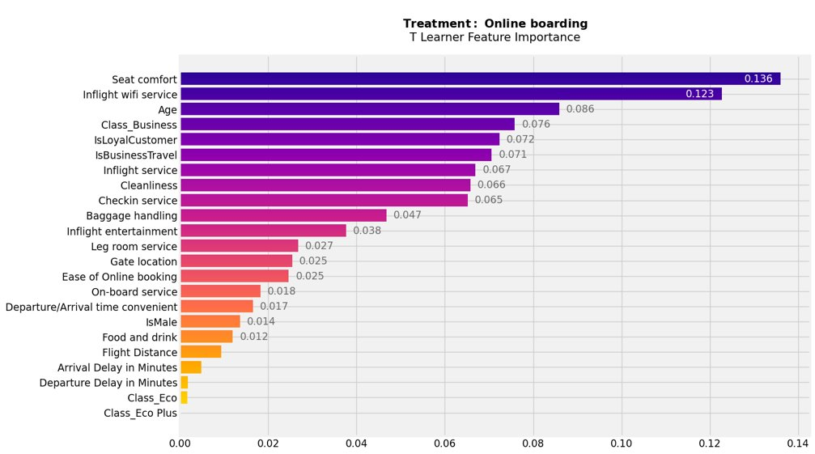
Preliminary Results
Treatment II: Online boarding

